Slide 1
Plant Anatomy and Physiology

Slide 2
Learning Objectives
Plant Anatomy and Physiology
  Summarize the role of each cell structure in plant development
  Evaluate the importance of various plant tissues in plant development
  Summarize the contribution of each organ within the plant body
  Evaluate the stages of plant growth and development
  Compare the various stages of plant reproduction
  Recommend appropriate plant growth regulators for various plants

Slide 3
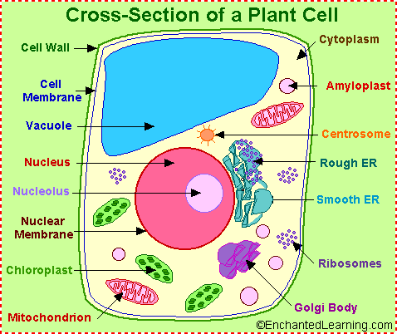
  Summarize the Role of Each Cell Structure in Plant Development

Slide 4
  Summarize the Role of Each Cell Structure in Plant Development
Cell Wall
  Outermost rigid covering of a plant cell
  Made mostly of cellulose
  Provides rigidity, strength and protection against mechanical stress and infection
Cell Membrane
  Outer boundary of the cell that encloses the cytoplasm
  Inside the cell wall
  Allows only certain substances to pass through
Vacuole
  Very large and well defined in plant cells
  Stores water and other materials
  Helps cells to maintain their shapes
Nucleus
  Control center of the cell
  Contains genetic material
Nucleolus
  Found inside the nucleus
  Site of ribosome synthesis
Nuclear Membrane
  Outer boundary of the nucleus
  Allows materials to pass through

Slide 5
  Summarize the Role of Each Cell Structure in Plant Development
Chloroplast
  The site of photosynthesis
  Contain chlorophyll, the green pigment in plants
Mitochondria
  The powerhouse of the cell,
  The site of cellular respiration which provides energy to the cell
Golgi Body or Apparatus
  Where proteins are packaged for transport
Ribosome
  Site of protein synthesis
Endoplasmic Reticulum
  Transports materials throughout the cell
Cytoplasm
  Gel like material inside the cell

Slide 6
  Summarize the Role of Each Cell Structure in Plant Development
Tour of a plant Cell
  https://www.youtube.com/watch?v=CZ4VT3PN3is

Slide 7
Summarize the Role of Each Cell Structure in Plant Development
Mitochondria
Cellular Respiration
Chloroplast
Photosynthesis
Happens in Plants and Animals
Occurs in the Mitochondria
Reactants
  Oxygen and Glucose
Products
  Carbon Dioxide and Water
Releases Energy
C₆H₁₂O₆ + 6O₂ → 6CO₂ + 6H₂O
Only Happens in Plants
Occurs in the Chloroplasts
Reactants
  Carbon Dioxide and Water
Products
  Oxygen and Glucose
Captures Energy
6CO₂ + 6H₂O → C₆H₁₂O₆ + 6O₂

Slide 8
  Evaluate the Importance of Various Plant Tissues in Plant Development
3 Tissue Systems
  Dermal
    Protection
    Prevention of water loss
  Ground
    Photosynthesis
    Food storage
    Regeneration
    Support
    Protection
  Vascular
    Transport of water, minerals and food
      Xylem
        Water
      Phloem
        Food

Slide 9
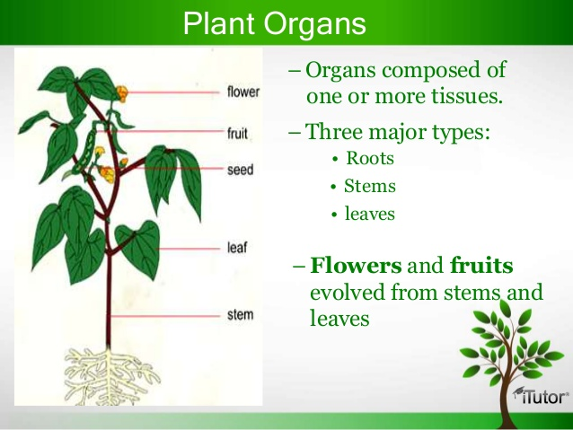
  Summarize the Contribution of Each Organ Within the Plant Body

Slide 10
  Summarize the Contribution of Each Organ Within the Plant Body
3 Major Types
  Leaves
    Photosynthesis
  Stems
    Support
    Transport
  Roots
    Anchor and support plants
    Absorb and conduct water and minerals
    Store products of photosynthesis

Slide 11
  Evaluate the Stages of Plant Growth and Development
3 Phases
  Germination
    Seeds germinate
    Roots and shoots emerge from the seed
    Plant begins to grow
  Vegetative Phase
    Increase in plant height
    Leaves are produced
    Roots continue to develop
    Energy is captured and stored
  Reproductive Phase
    Flowering begins
    Plant is mature
    Pollination can occur

Slide 12
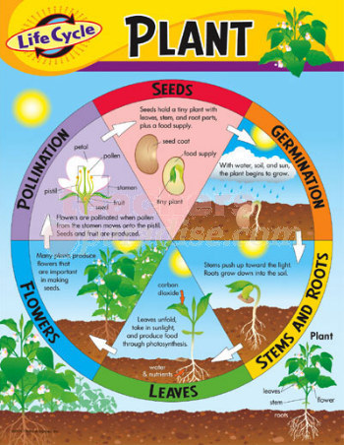
  Compare the Various Stages of Plant Reproduction

Slide 13
  Compare the Various Stages of Plant Reproduction
7 Stages
  Pollination
    Pollen grains (carrying male gametes) are carried to the female parts of the plant
  Fertilization
    Male and female gametes unite and form a zygote
  Seed Formation
    Zygote continues growth to an embryonic plant
    Remaining seed structures are formed
  Seed Dispersal
    Seeds are spread by wind, water, animals or insects
  Germination
    Plant begins to grow from seed
  Continued Growth
    Plant grows
      Juvenile plants cannot reproduce
      Mature plants are capable of reproduction
  Pollination
    Pollen grains (carrying male gametes) are carried to the female parts of the plant

Slide 14
  Recommend Appropriate Plant Growth Regulators for Various Plants
Plant Growth Regulators
  Chemicals designed to affect plant growth and/or development
  Most effective when applied at the appropriate times to regulate plant growth or development
    Must be applied before overgrowth occurs
    Can’t “shrink” an overgrown plant

Slide 15
  Recommend Appropriate Plant Growth Regulators for Various Plants
Goals of Plant Growth Regulators
  Regulate Shoot Growth
    Growth retardant
  Increase Plant Branching
    Branching agent or “chemical pincher”
  Enhance flower initiation or synchronize flowering
    Chlormequat chloride or gibberellic acid
  Remove flowers to increase the number of vegetative cuttings
    Ethylene-generating compound

